Slide 1
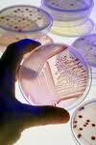
Micro Lab Notes

Slide 2
DAY 1 – MCB 2010C Microbiology
How to get to printed materials:
1) Sign into Valencia’s homepage.
2) Click on “Current Students.”
3) Click on “Faculty Websites.”
4) Click on “A” and then “Ahmed.”
5) In my website, you can click on “Syllabus” to print it.
6) Also, in my website, you can click on “Course Materials” for all the other printable materials you will need for the course
(only print the materials when you are asked).

Slide 3
FOR DAY 1 OF CLASS/LAB
1) Read and know the syllabus.
2) Print the CHEMISTRY HW (from course materials on the website). It is DUE in 2 WEEKS.
3) Print or have access to the MICRO LAB NOTES (from course materials on the website).
4) Print or have access to LECTURE PACKET #1 (from course materials on the website).
5) Read pages 1-6 in the lab manual for your lab, to understand lab safety.

Slide 4
FOR EACH LAB:
- Disinfect your table top before and after each lab period; wash your hands before leaving the lab.
- NO FOOD or DRINKS are allowed in the lab.
- You must have a lab jacket (or suitable substitute for each lab, beginning at next week’s lab).
- You will need latex or similar type gloves for each lab (several pairs beginning at next week’s lab)
- The lab manual for this course is required.
- You must wear appropriate footwear (close toe shoes; no high heels) in the lab.
- You will need a Sharpie for every lab.
- You need to remove all personal property, that you cant afford to lose (other than your lab manual), from on and from around your desk.
- You may want to bring colored pencils and/or pens.

Slide 5
MICROBIOLOGY SCAVENGER HUNT
- disinfectant solution for lab benches - antiseptic hand washing soap
- fire extinguisher; fire blanket - fire alarms
- MSDS folder - emergency shut off valves
- biohazard waste containers - biohazard sharps container
- broken glassware box - “kill cart”
- first aid kit; chemical spill kit - security telephone
- 25°C and 37°C incubators - 4°C refrigerated room
- biological safety cabinet - microscopes
- vortex mixers - 4 pathways to exit the room
- emergency shower and eyewash - Louis Pasteur
- water baths - UV light chamber
- autoclaves (students need to be escorted to observe them and you will be taught how they work and why we need them)
- inoculating loops, flint strikers, plastic pipettes, ethanol, distilled water, sterile cotton swabs, microscope lens cleaner and lens paper, test tube racks, immersion oil

Slide 6
HOW TO USE A MICROSCOPE
1. Plug the microscope in and turn on the light switch; then adjust the light intensity control knob (rheostat) to increase and decrease the amount of light going through the stage.
2. Lower the stage, using the coarse adjustment knob, and then put your slide on the stage, so that it is held in place with the stage clips.
3. Use your mechanical stage knobs, while looking directly at the slide, to position the slide so light is going through the object that you wish to observe.
4. Making sure that the scanner lens is directly above the stage, raise the stage using the coarse adjustment knob while looking through the ocular lenses until you see your image come into view.

Slide 7
5. Using your fine adjustment knob, fine focus the specimen you are looking at on the slide.
6. Before moving to the next higher power of magnification (the low power lens), you must CENTER THE SPECIMEN on the slide in the field of view. Do this while looking through the oculars at your specimen by using your mechanical stage knobs.
7. Rotate the revolving nosepiece so that the LOW power objective lens is now above the slide. Your microscopes are PARFOCAL; do you need to lower the stage when trying to find your specimen as you move to a higher power objective lens, so you don’t hit the higher power lens with the slide on the stage?

Slide 8
8. FOCUS the specimen on the slide using your fine adjustment knob.
9. Center the specimen on the slide, under low power, using the mechanical stage knobs.
10. Rotate the nosepiece to the HIGH POWER objective lens and focus the specimen by only using the fine adjustment knob.
11. Be sure you can identify each of the microbes that you are supposed to observe in this lab.

Slide 9
MICROSCOPE STORAGE:
1. The rheostat wheel needs to be set to the lowest light intensity.
2. The on/off switch is then turned off.
3. The stage needs to be set slightly above its lowest position.
4. The mechanical stage should be centered.
5. The objective lenses are clean and free from any oil buildup, properly cleaned with only lens paper and lens cleaner. If using the oil immersion lens make sure the lens is oil free when the students check out.
6. The objective lenses are set so the 4X lens is directly above the stage.
7. The electrical cord is wrapped properly.
8. The arm is facing you when the microscope is replaced in the storage cabinet.
9. The cabinet door closes properly when the microscope is in place.

Slide 10
LAB 1-4 STREAK PLATE METHODS of ISOLATION
Sample the following:
Table 1 – sink faucet
Table 2 – sponges at sink
Table 3 – men's urinal
Table 4 – women’s toilet bowl
Table 5 – bottoms of purses and book bags
Table 6 – water fountain spigot
Table 7 – bottoms of your shoes

Slide 11
Lab 3-3: Examination of Eukaryotic Microorganisms
Kingdom Eubacteria:
Oscillatoria (cyanobacterium – a prokaryote)
Kingdom Protista: subkingdom protozoa:
Amoeba proteus
Paramecium caudatum
Giardia lamblia √
Human blood with Plasmodium sp. (malarial parasites) √ subkingdom algae:
Volvox
Spirogyra
Diatoms
Euglena (can be autotrophic or heterotrophic)

Slide 12
Kingdom Fungi:
Saccharomyces (yeast)
Mold Types slide has the following 3 molds: √
Penicillium
Rhizopus
Aspergillus
Kingdom Animalia:
Dipylidium caninum (dog tapeworm)
Pediculus humanis corporis (human body louse – an insect)
KNOW to which kingdom each of these organisms belong.

Slide 13

What is this?

Slide 14
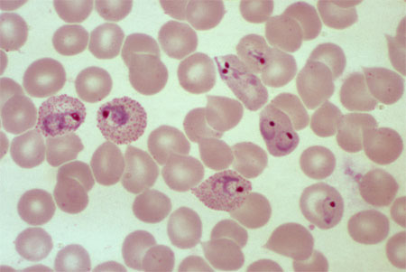
What is this?

Slide 15
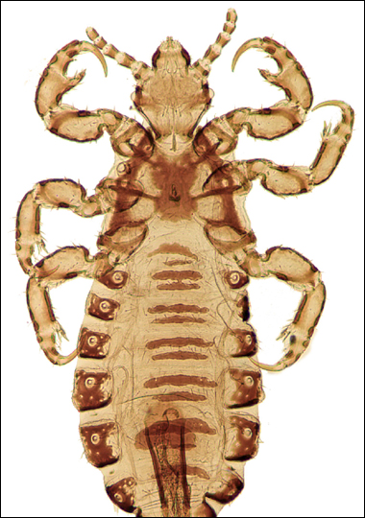
What is this?

Slide 16
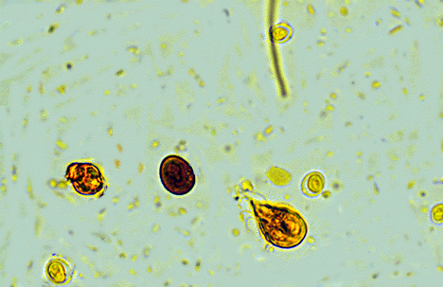
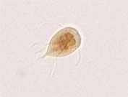
What is this?

Slide 17
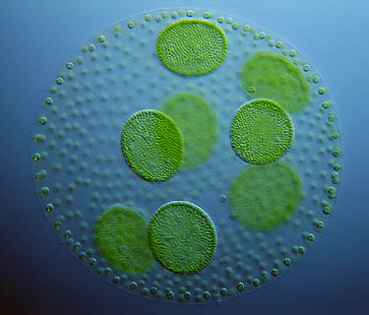
What is this?

Slide 18
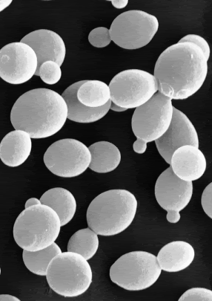
What is this?

Slide 19
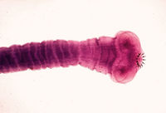
What is this?

Slide 20
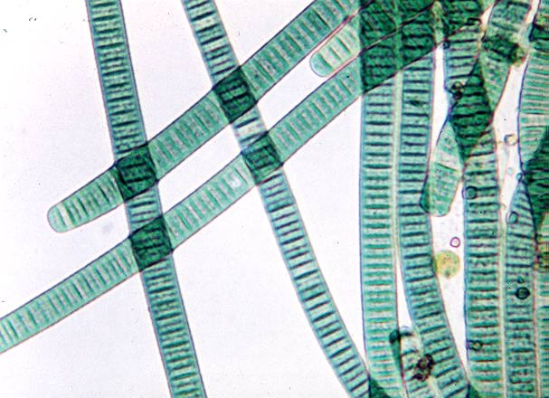
What is this?

Slide 21
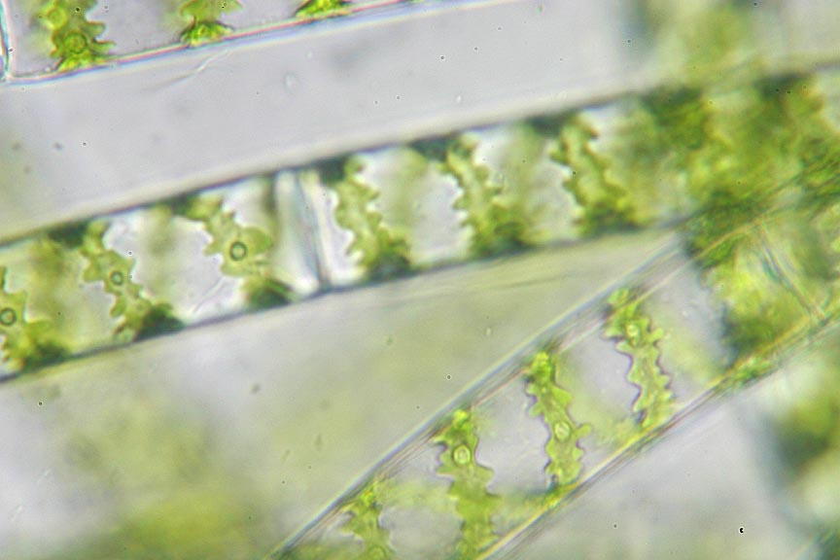
What is this?

Slide 22
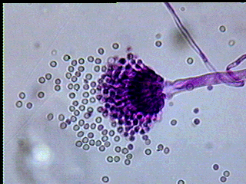
What is this?

Slide 23
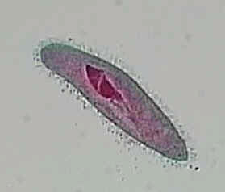
What is this?

Slide 24
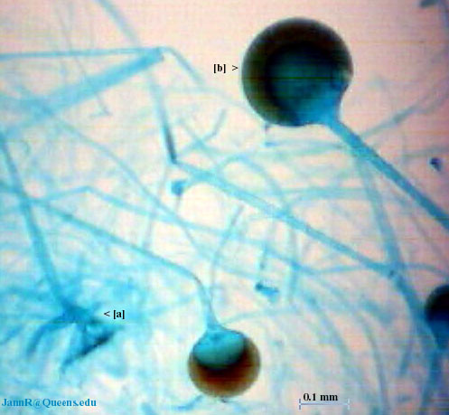
What is this?

Slide 25
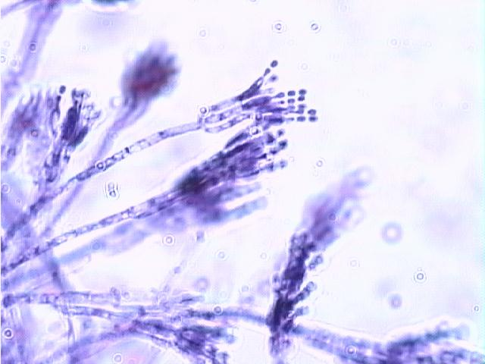
What is this?

Slide 26
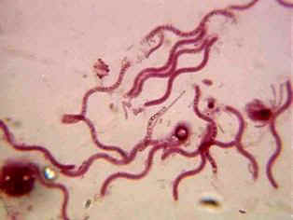
What is this?

Slide 27
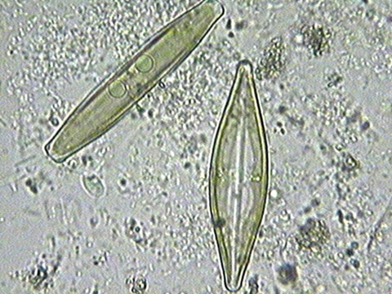
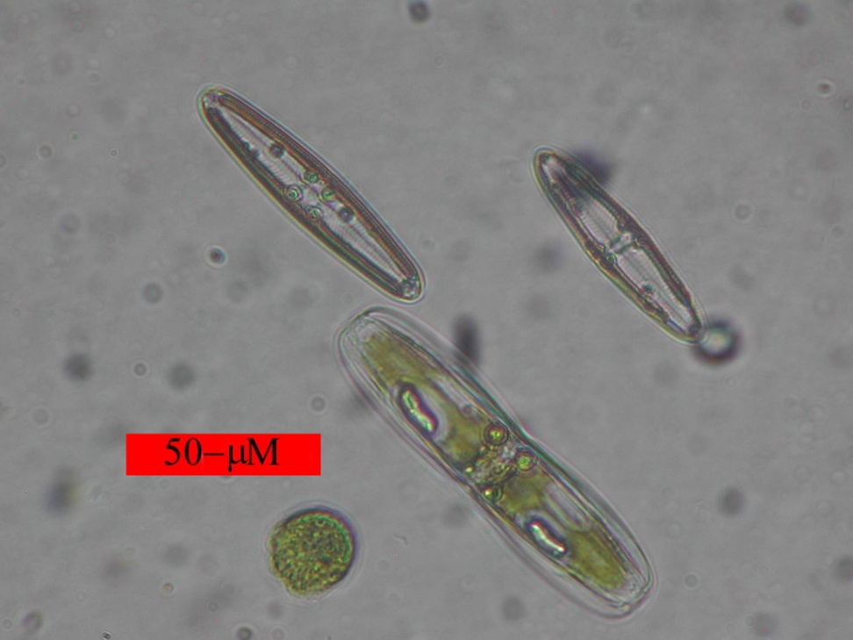
What is this?

Slide 28
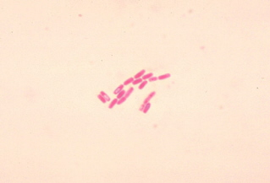
What is this?

Slide 29

What is this?

Slide 30
MICROBIOLOGY STUDENTS
BEFORE LEAVING, PLEASE BE SURE TO:
Have your microscope checked out (if you used one) by your instructor to be sure that all oil is removed from the lenses and that the microscope is ready for storage in the cabinet.
Clean slides as directed by your professor.
AND…………………………………….

Slide 31
Remove all markings from used glass test tubes, using alcohol wipes. When finished, put the contaminated test tubes in the kill cart, filling any existing test tube racks first.
Discard all Petri dish cultures in the biohazard waste containers (orange lined trash cans).
Return all equipment (loops, wires, flint strikers, immersion oil, lens paper) to your drawer.
Put seats under the lab tables, disinfect tabletops and wash your hands.
Thank you for cleaning up after yourselves ☺

Slide 32
UV Light Lab
- UV C rays (254 nm) can kill bacteria
- The more the time of exposure, the greater the killing effect; spore formers are more resistant than non-spore formers.
- Fungi are less affected by UV C rays than are bacteria
- UV rays are very poorly penetrating and were blocked by the plastic Petri plate lid (the control plate with no UV exposure and the 5 minute lid on plate had identical microbial growth)
- How do UV C rays kill bacteria? By creating THYMINE DIMERS which block DNA polymerase from allowing DNA replication and which block RNA polymerase from allowing the transcription of a gene. (LAB 8-2)

Slide 33
THE ELISA TEST (Enzyme Linked Immunosorbent Assay)
Detects antibodies in your blood to determine if you have been exposed to a disease.
Can be used to detect diseases (including HIV, SARS, West Nile encephalitis, Lyme disease, Avian flu).
Can be used in pregnancy and ovulation test kits, detecting illegal drugs (marijuana and cocaine), testing indoor air quality, and to determine if foods have been labeled properly.
Remember that each antibody reacts specifically with only one antigen.
Rapid results!!

Slide 34
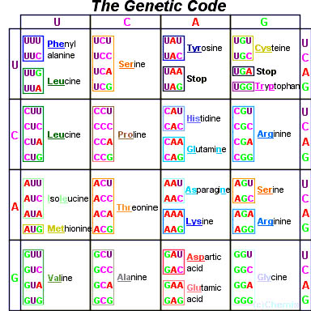
SOLVE THIS PROBLEM:
From the DNA strand
3‘AGGCTTCGA5’
a) Determine the mRNA that is transcribed from it.
b) Determine the tRNA anticodons that are complimentary to that mRNA.
c) Determine the 3 amino acids that the DNA coded for to make a polypeptide chain.

Slide 35
AND DO THIS PROBLEM:
A mutation occurs to cause
3‘AGGCTTCGA5‘ to be changed to
3‘AGCGCTTCGA5‘.
What type of mutation occurred?
What will the 3rd amino acid coded for after the mutation?

